Slide 1
Plenary - You Say We Pay
Try to describe the following components without actually naming them!

Slide 2
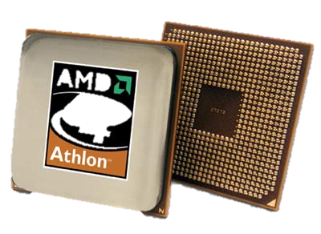
Components of a computer system. A computer system

Slide 3
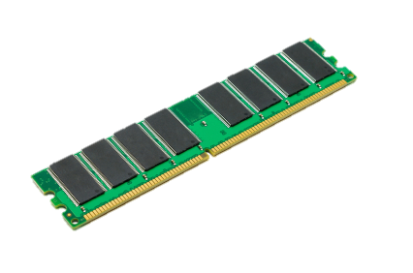
Components of a computer system. A computer system

Slide 4
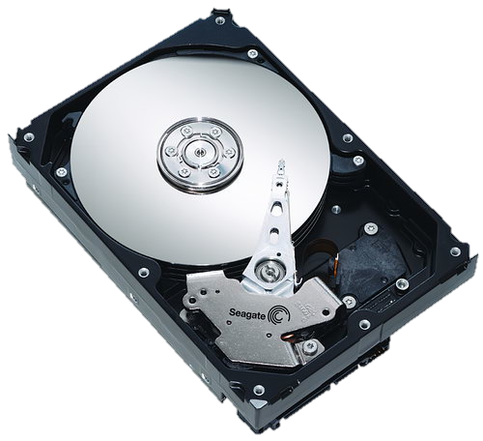
Components of a computer system. A computer system

Slide 5
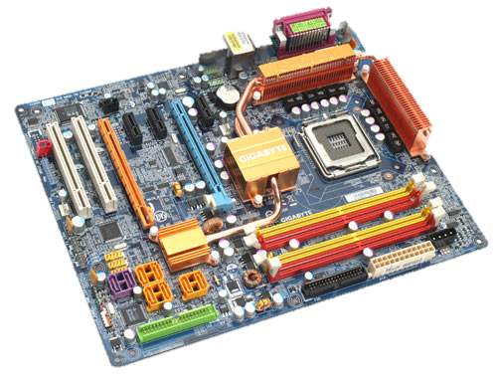
Components of a computer system. A computer system

Slide 6
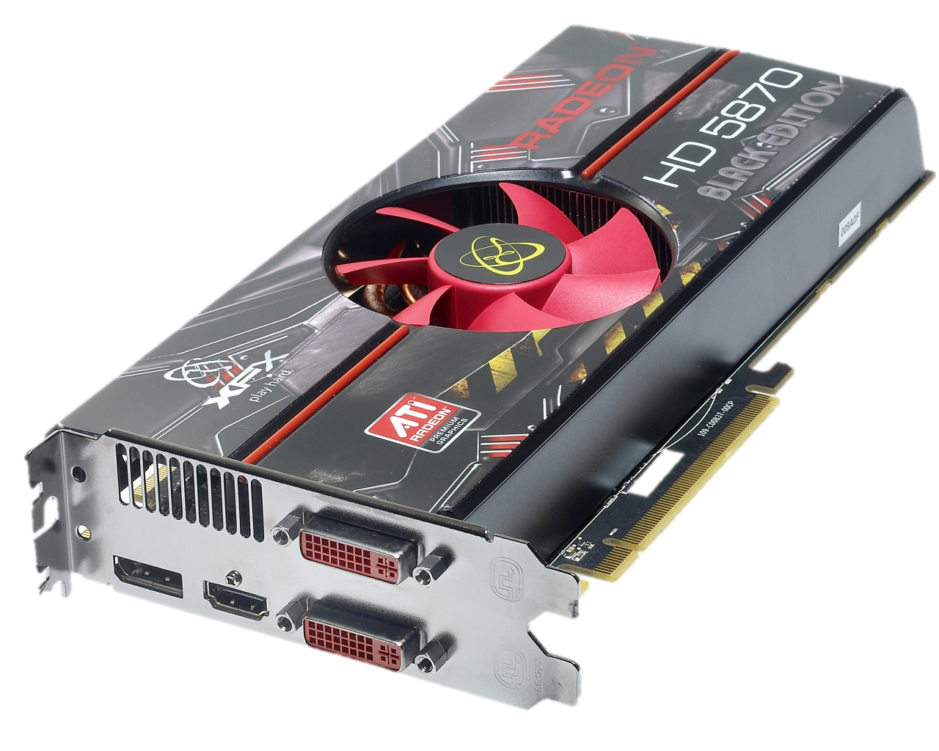
Components of a computer system. A computer system

Slide 7
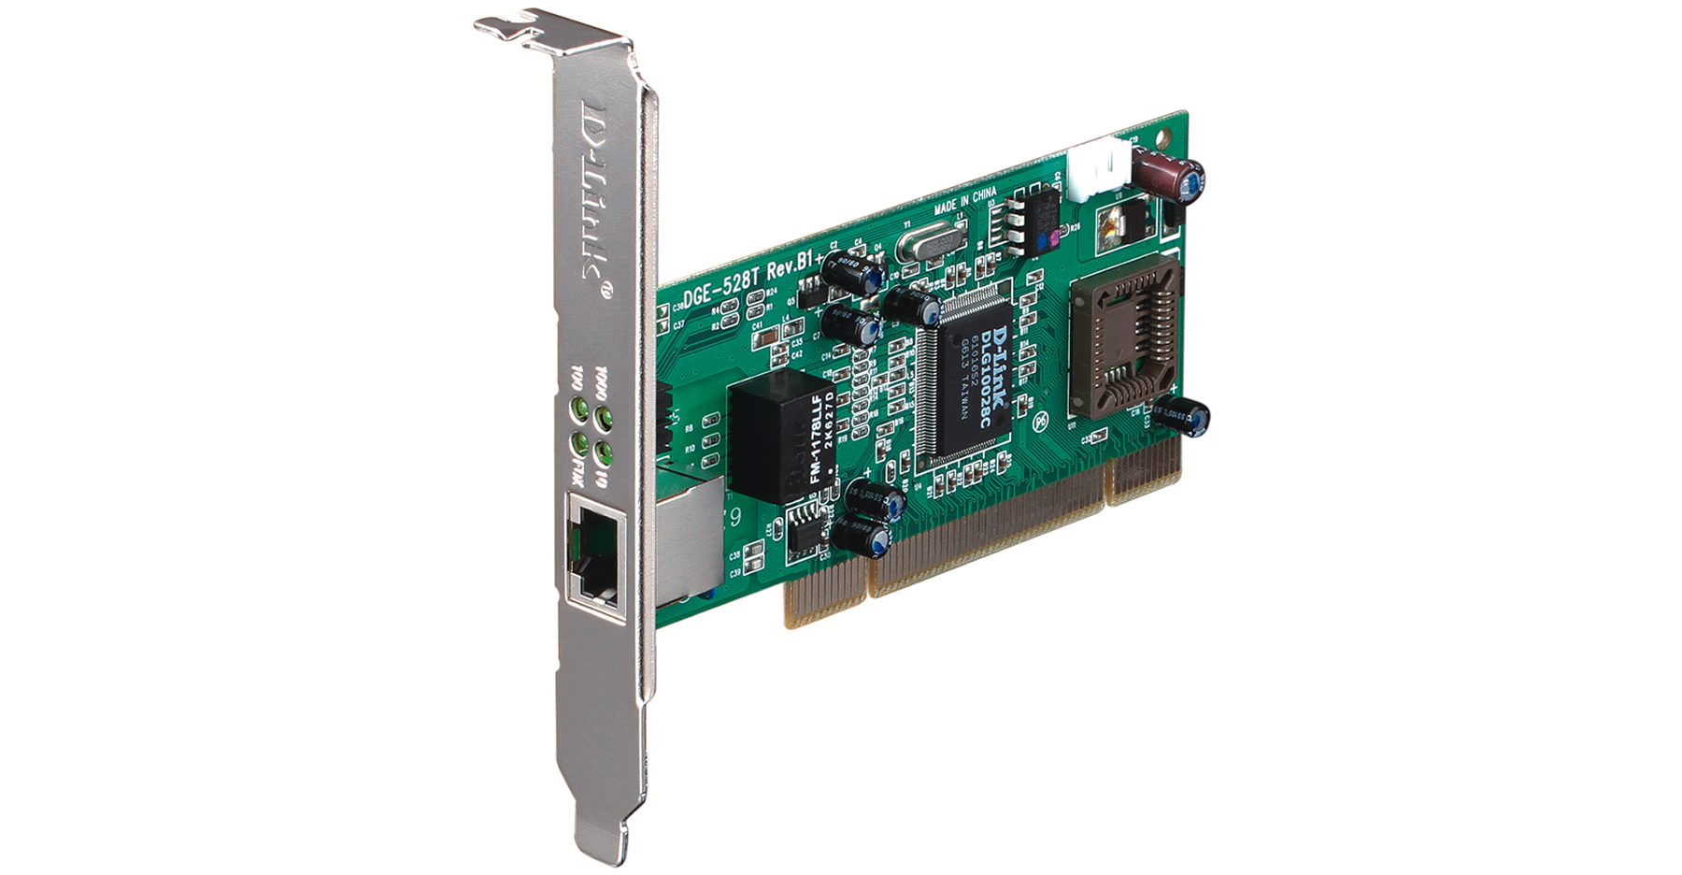
Components of a computer system. A computer system

Slide 8
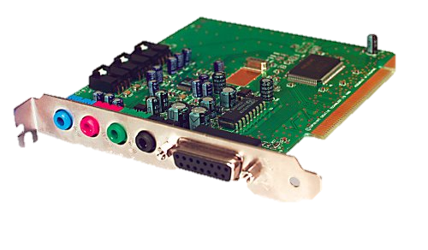
Components of a computer system. A computer system

